Slide 1
Robust Parallel Adaptive Smoothing
Danny Gibbs II
Christopher K. Lee
CS205 Final Project
4 December 2011

Slide 2
Agenda
Adaptive Smoothing
Example
CPU and GPU/MPI Implementations
Results
Conclusions
Summary

Slide 3
Adaptive Smoothing
Independently Smooth Each Pixel
Preserve Small Scale Features
Larger Features Smoothed Out
Only Scales To Threshold or MaxRad
Preserve Energy (Flux)

Slide 4
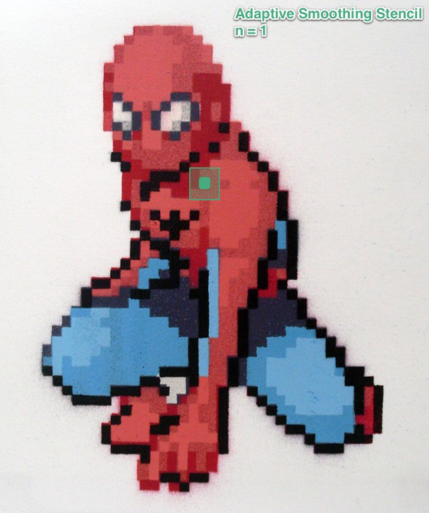
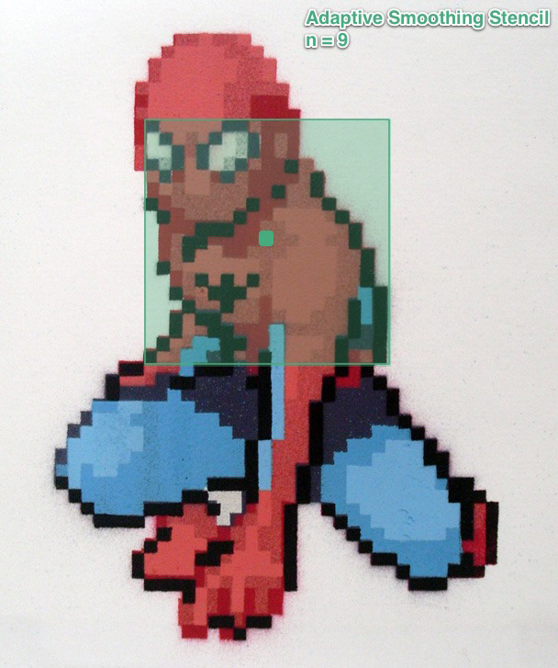
Example of Adaptive Smoothing

Slide 5
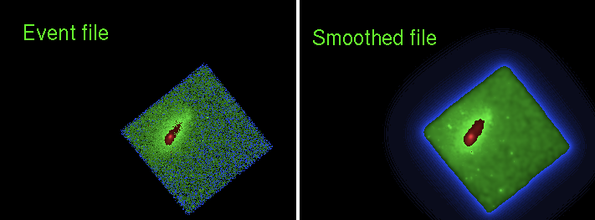
Observation ID: 11759

Slide 6
CPU Implementation
Traditional Chandra Observation
  dmimgadapt()
  Worst Case: O(n⁴)
  8192x8192 binned to 1024x1024
  Run Time: ~ 30 minutes

Slide 7
GPU/MPI Implementation
GPU
  Embarrassingly Parallel
  Use full resolution image
MPI
  Process Multiple Observations

Slide 8
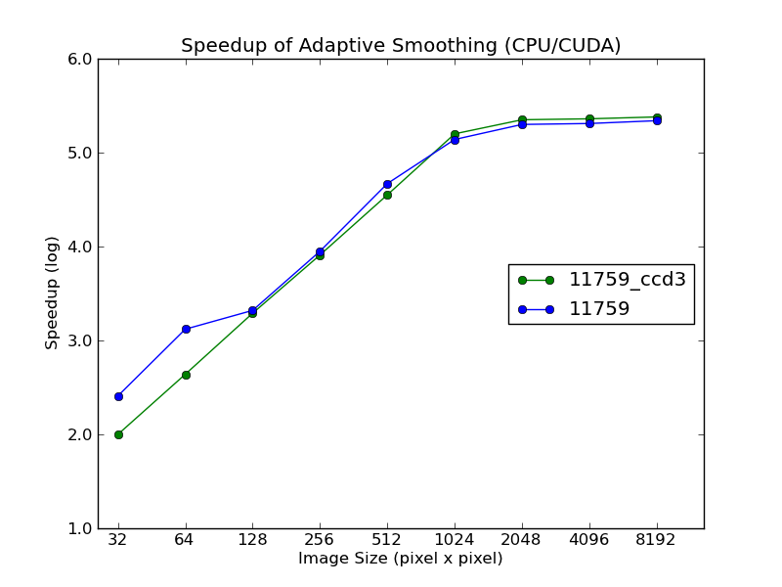
Results

Slide 9
Conclusions
CPU vs GPU
  Full Resolution Image
    CPU: ~ 4.5 Days
    GPU: ~ 1.65 sec
  Speed Up of ~10⁵

Slide 10
Summary
Adaptive Smoothing
Example
CPU and GPU/MPI Implementations
Results
Conclusions

Slide 11
Acknowledgments
      CIAO: Chandra's data analysis system
      Fruscione et al. 2006, SPIE Proc. 6270, 62701V, D.R. Silvia & R.E. Doxsey, eds.
      Special thanks to Kenny Glotfelty of the Harvard-Smithsonian Center For Astrophysics

